Slide 1
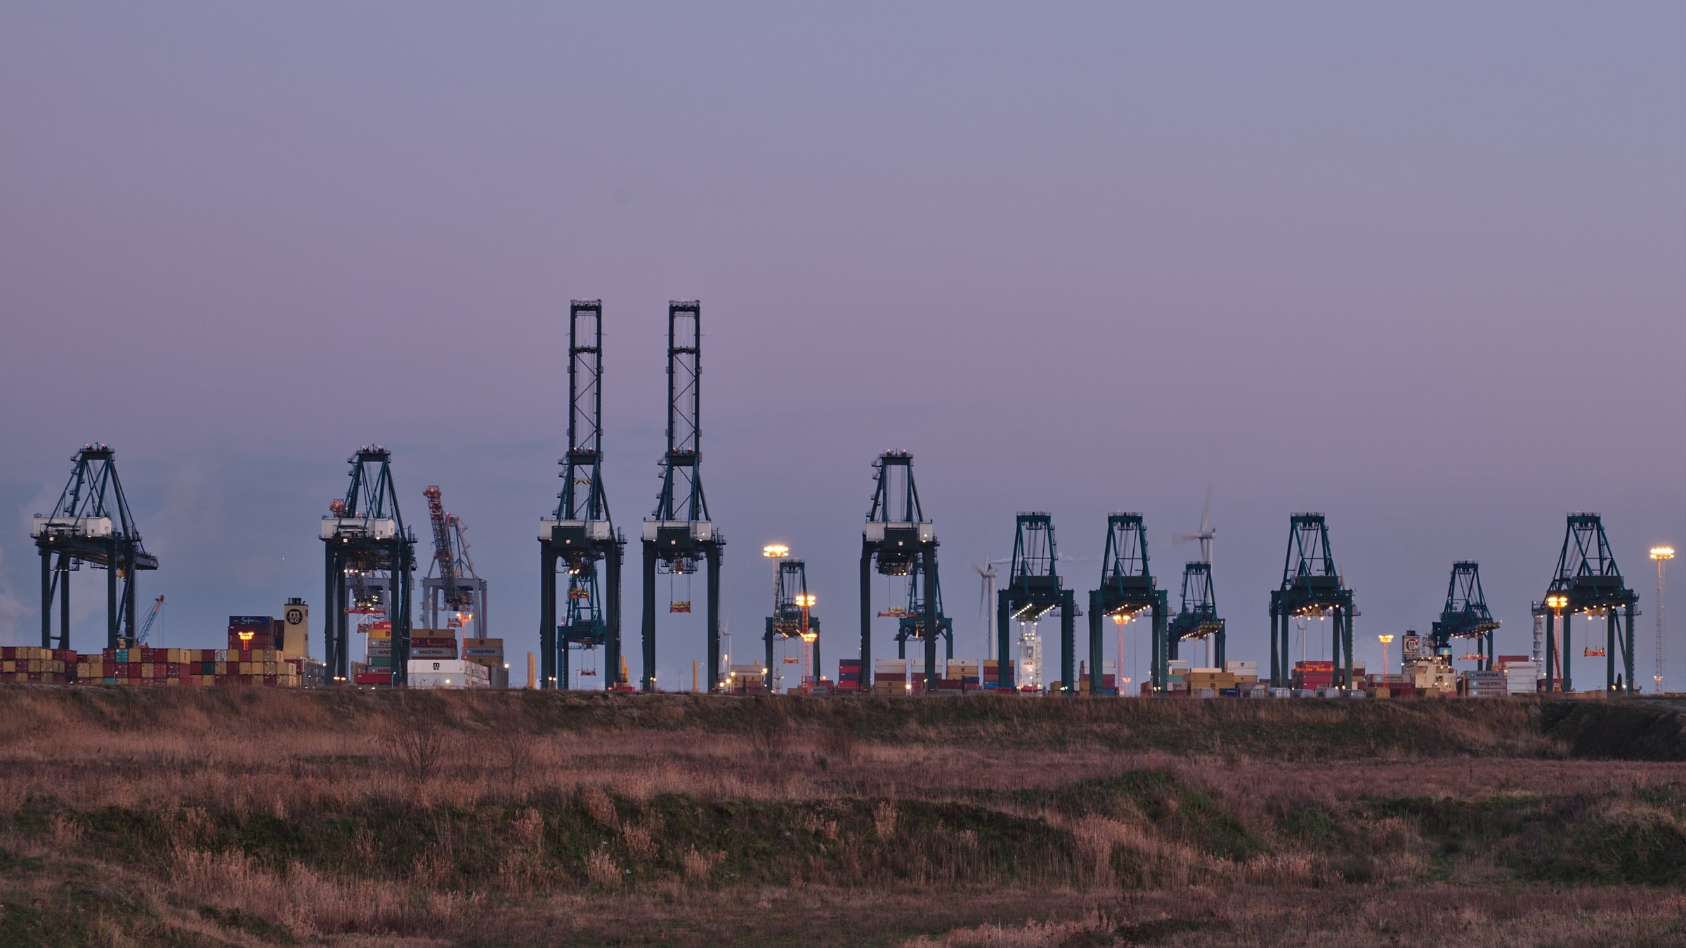


CONNECTING
TRADE
EMPOWERING
GROWTH
ONE-STOP CROSS-BORDER LOGISTICS
MAKING CROSS-BORDER
TRADE SIMPLER
让跨境贸易更简单
MORE THAN SHIPPING
A BRIGHTER TOMORROW
TRUSTED SERVICE
A STRONGER TOMORROW
XIAMEN HQ
+86 592-5772527

Slide 2
OVERVIEW
COOL WORLD AT A GLANCE
酷界国际一览
Headquartered in Xiamen, Cool World International is a licensed freight
forwarder holding both China MOC NVOCC and US FMC registration. We deliver
end-to-end cross-border solutions across ocean, air, rail, warehousing, logistics
management and e-commerce supply chain.
End-to-end service from booking and customs to final
delivery — first-hand rates, space under our control.
9
6
5
2
Direct Carrier Contracts
China Port Network
Global Offices
International Licences
Tier-1 carrier agreements
Xiamen HQ + 5 major Chinese ports
Xiamen · Guangzhou · Shenzhen ·
HCMC · Port Klang
China MOC NVOCC + US FMC
registration
First-hand rates & space | China MOC + US FMC licensed | Full-chain visibility
COOL WORLD INTERNATIONAL

Slide 3
SERVICE LINES
END-TO-END, ONE-STOP LOGISTICS
端到端的一站式物流服务
01
02
03
Ocean Freight
Air Freight
Warehousing
海运服务
空运服务
仓储服务
Tier-1 carrier rates, FCL space and self-operated LCL
consolidation.
Charter flights, airline block space and dangerous
goods, door to door.
Local and overseas warehouses, packing, palletising
and labelling.
04
05
06
Railway Freight
Logistics Management
E-commerce Supply Chain
铁路运输
全球物流管理
跨境电商供应链
China–Europe rail and sea-rail intermodal, plus
container leasing.
Import & export customs, documentation, cargo
insurance, risk control.
FBA first-mile booking with sea and air parcel
programmes.

Slide 4
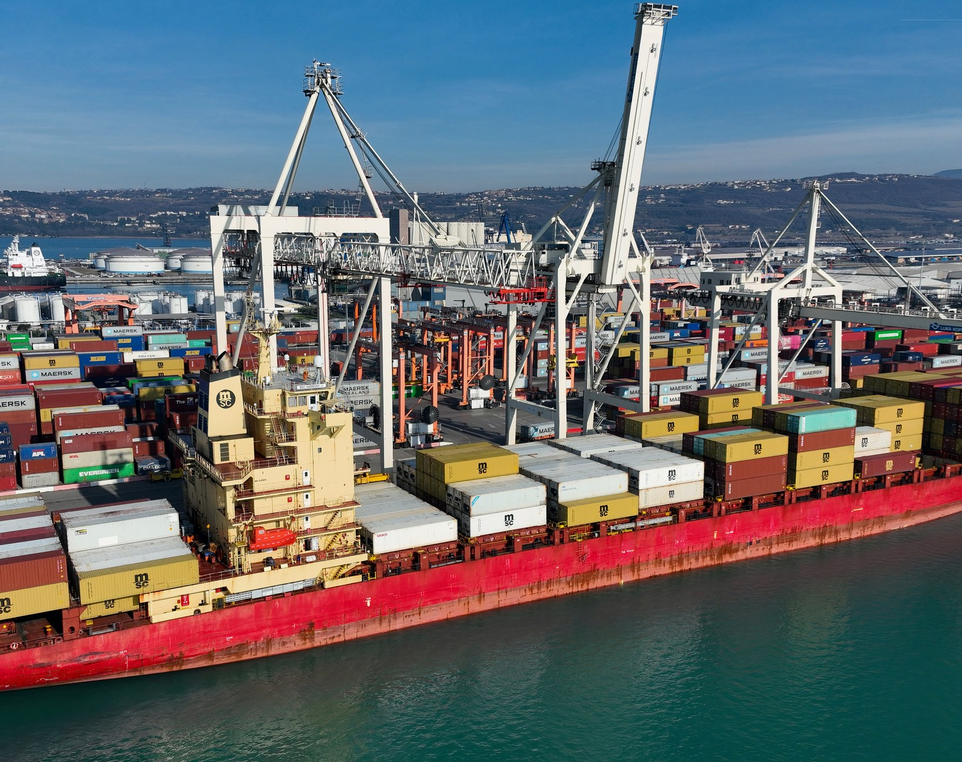
CORE BUSINESS
OCEAN FREIGHT — RATES & SPACE
海运：一手运价与舱位
First-hand FCL Rates & Space
Carrier-direct pricing with guaranteed allocations
Self-operated LCL Consolidation
Weekly sailings, consolidation space under our control
OOG & Oversized Cargo
Flat racks, open tops and break-bulk handling
FCL
LCL
OOG
Full Container Load
Less than Container Load
Out-of-Gauge Cargo
9
Direct Carrier Contracts
Tier-1 carriers · FCL & LCL
OCEAN FREIGHT

Slide 5
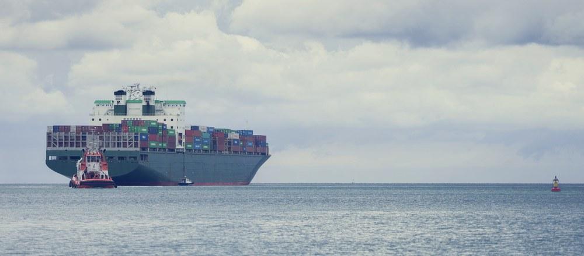
GLOBAL NETWORK
6 CHINA PORTS · 5 GLOBAL OFFICES
六大中国口岸，五大全球办公点
China Port Network
Global Offices
中国口岸服务网络
全球办公点
Xiamen · HQ
Fuzhou
Xiamen · HQ
Guangzhou
Shenzhen
Ningbo
Shenzhen
Ho Chi Minh City
Shanghai
Qingdao
Port Klang
OVERSEAS COMPANIES
Vietnam · Ho Chi Minh City
Malaysia · Port Klang
Sales · Operations · Documentation
Transhipment · DDP Delivery

Slide 6
CORE CORRIDORS
THREE CORE TRADE CORRIDORS
中国、东南亚、北美关键通道
Xiamen ⇄ Vietnam
2 Days Direct
Vietnam → USA
17 Days Direct
China ⇄ Malaysia → USA
6 Days Direct
Xiamen
Ho Chi Minh
Vietnam
US West Coast
Xiamen
Port Klang West
Ho Chi Minh · Hai Phong · Da Nang — fastest direct
sailing from South China
USWC from 17 days, USEC from 34 days
Transit via Port Klang West to North America, with
DDP door delivery
TRANS-PACIFIC DIRECT SERVICES
FASTEST SOUTH CHINA SAILING
DDP DOOR DELIVERY AVAILABLE
DIRECT TRANSIT TIMES
Vietnam → USWC from 17 days — the fastest trans-Pacific lane here
Xiamen → Vietnam
2D
Xiamen → Port Klang West
6D
Vietnam → USWC
17D
Vietnam → USEC
34D

Slide 7
SERVICE PROCESS
FROM BOOKING TO DELIVERY, ONE TEAM
从订舱到签收，全流程有人跟
SERVICE PROCESS
Delivery Guarantee
WHAT YOU GET
Quotation & Booking
询价与订舱
First-hand rates, transparent pricing
Container Pickup & Loading
提柜与装箱
Self-operated LCL consolidation
Customs & Documentation
报关与单证
Customs, docs and cargo insurance
Loading & Departure
装船与开航
Full-chain visibility and alerts
Transit Tracking
在途跟踪
Overseas DDP door delivery
Arrival & Delivery
Xiamen · Vietnam · Malaysia — three teams, one
workflow
到港与派送

Slide 8
LICENSING & CARRIERS
DUAL LICENCES, 9 TIER-1 CARRIER CONTRACTS
双资质，九家船司一级合约
China MOC NVOCC
US FMC Registered
中国无船承运人资质
美国联邦海事委员会注册
DIRECT CARRIER CONTRACTS
MASTON
COSCO
EMC
OOCL
ZIM
WHL
YML
ONE
HMM

Slide 9
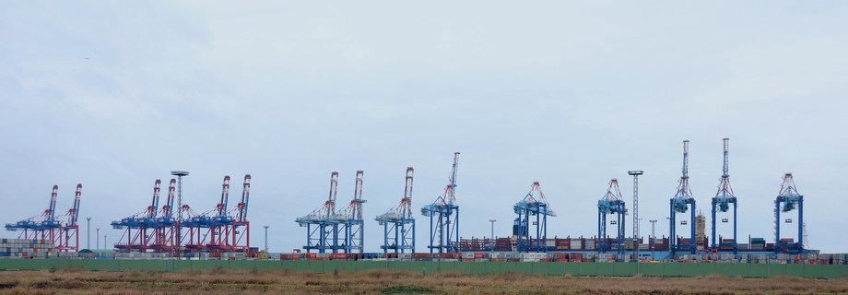
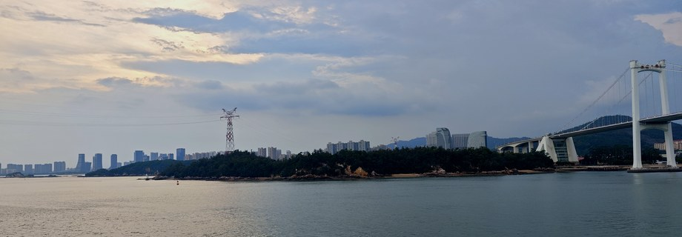
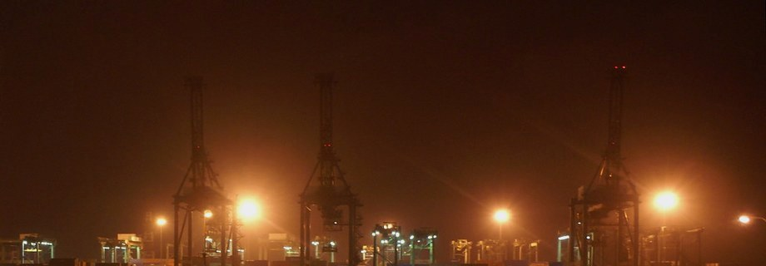
WHY COOL WORLD
WHY COOL WORLD
为什么选择酷界
01
02
03
First-hand Rates & Space
Dual International Licences
Visible Global Network
一手运价与舱位
双重国际资质
全球网络可视
Self-operated LCL gives us first-hand FCL rates
and space — controlled cost, reliable transit.
China MOC NVOCC and US FMC registration,
with compliant customs and documentation.
Ocean, air and e-commerce cargo tracked end
to end, with teams across three countries.
First-hand rates, secured space, one chain end to end
ONE TEAM · ONE CHAIN
From Xiamen to North America, one team takes full ownership

Slide 10
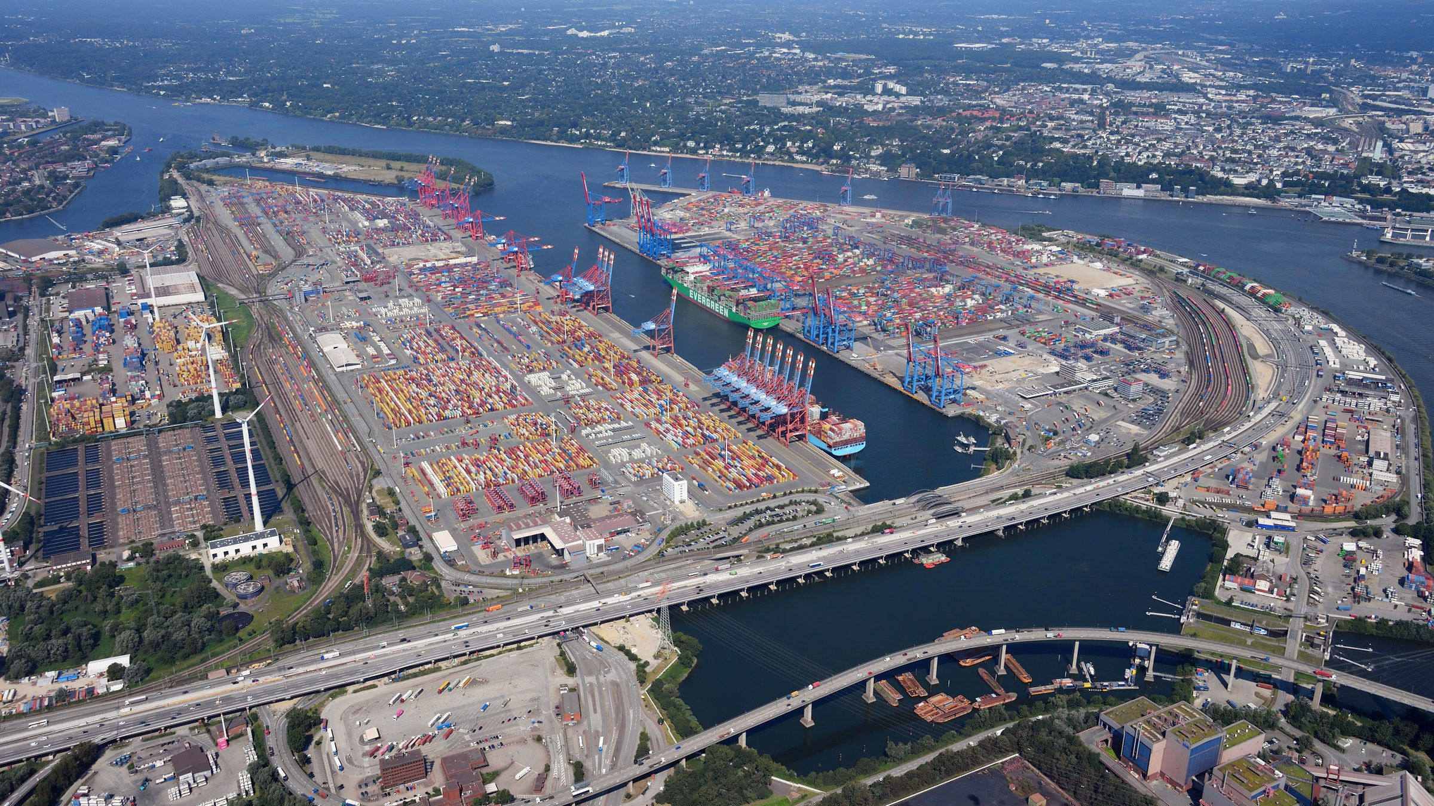
LET'S TALK
LET'S MOVE FORWARD TOGETHER
携手并进，互利共赢
Tell us your cargo and destination — a dedicated consultant will build your logistics plan.
TALK TO A SPECIALIST
XIAMEN HQ DIRECT LINE
+86 592-5772527
TRUSTED SERVICE
A STRONGER TOMORROW
COOL WORLD INTERNATIONAL CO., LTD.
THANK YOU FOR YOUR TRUST

